Slide 1
Quantum dots
Coco & Maggie
Notes:
Dear boss and colleagues, it’s our great honor to be here today and present you our ideas of quantum dots.
I’m Maggie. I’m Coco.
Our presentation will be composed of four parts, they are:

Slide 2
What are Quantum dots?
What is special?
Why our technology?
How will it work?
Notes:
…
We will first introduce you what is quantum dots.
OK. Let’s first think about this. Scientists can now precisely control every single atom. They make things lit up in certain colors and use that to do all kinds of things that used to be impossible.
That sounds insane, right? But now we manage to do something very similar because of the discovery of quantum dots!
So, what is quantum dots?

Slide 3
Size
Tiny
Semi-conductive
Reaction time
What is QUANTUM DOTS?
Color
Frequency
Energy
Notes:
Just like the name, quantum dots are very tiny semiconductor particles that can penetrate into small point. They can emit light of specific frequencies, and these frequencies can be changed by changing the dots' size.
To investigate further, me and Coco did a simple experiment of quantum dots, and she will now present the result.

Slide 4
Notes:
So the first graph shows the relationship between the reaction time and color of the quantum dots. The color here is represented in frequencies, and the smaller in frequency, the closer it is closer to red, so this graph basically shows this:

Slide 5
Time
Color
Notes:
As we can see, as time pass by, the color becomes redder.

Slide 6
Notes:
The second graph shows the relationship between dot size and reaction time. So according to the graph, we can see that there is a positive relationship.

Slide 7
Notes:
And the third graph shows the relationship between dot size and frequency, it is an inverse relationship. This graph actually put the first and second graph together, showing us that as time goes by, the color gets redder, meaning the frequency gets lower because the dot size gets bigger.

Slide 8
Notes:
Then the fourth graph shows the relationship between energy and frequency. They are exactly proportional because we used the formula E = hf to calculate the energy.

Slide 9
Notes:
The last graph is about dot size and energy. Because energy and frequency have a positive relationship, and frequency and dot size has an inverse relationship, so it’s easy to understand why the graph is downward sloping.

Slide 10
We can create different colors of quantum dots by controlling the reaction time!
The fluorescent effect!
What makes quantum dots special or unique?
Controlling the color by controlling the dot size
The color of quantum dots is stable!
Small size!
Notes:
So what makes quantum dots unique?
Well, there are so many things that can make you think it’s unique:
The fluorescent effect, meaning that they can fluoresce under UV light and that color is actually quite stable!
Size! They are really small so they can penetrate into small points!
And most excitingly, the property that the color changes according to the dot size!
So using these special properties, I am planning to do something interesting.

Slide 11

Military Camouflage

Slide 12
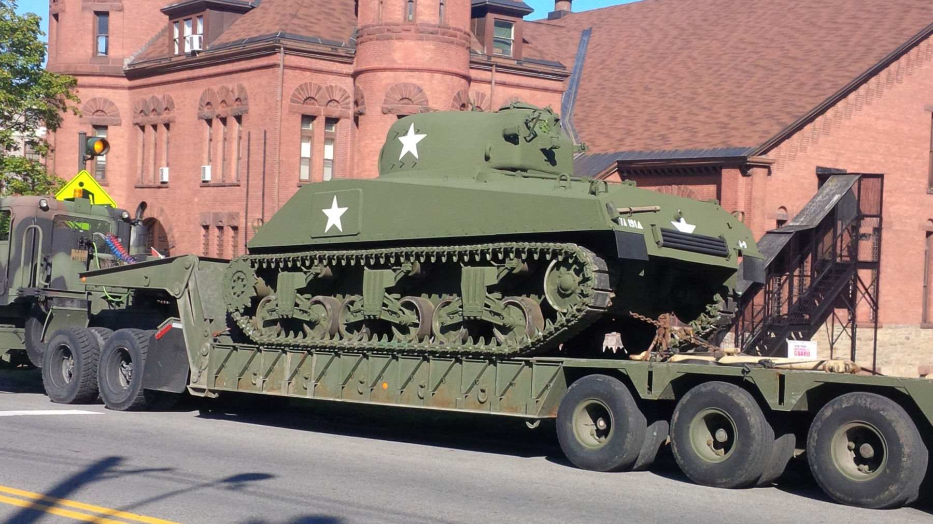
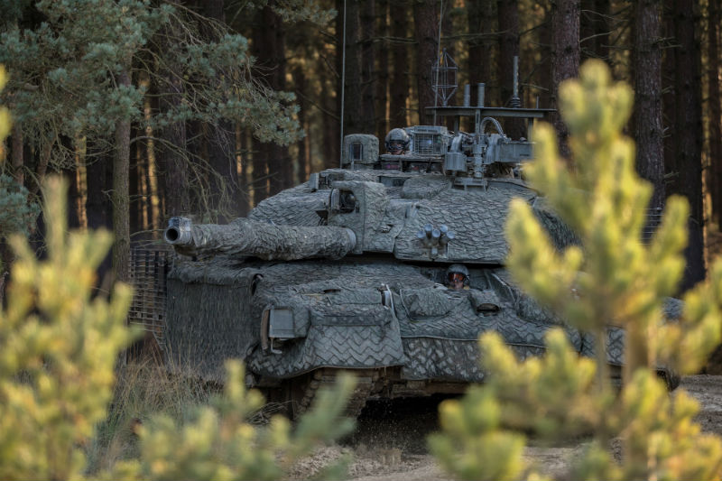

Slide 13
Thank you!

